Slide 1
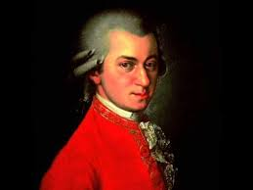
The Masterpiece of Procrastination
Composed by: Adolphus Lye (Year 1 PhD Candidate)
Institute for Risk and Uncertainty
Email: adolphus.lye@liverpool.ac.uk; LinkedIn: Adolphus Lye

Slide 2
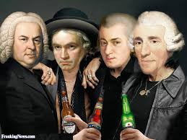
The Story of “Don Giovanni’s” Overture Mozart’s Midnight Masterpiece
28th October 1787 - One night before “Don Giovanni’s “ Premiere
Fun Fact: He had NOT even started composing the Overture!!!!

Slide 3
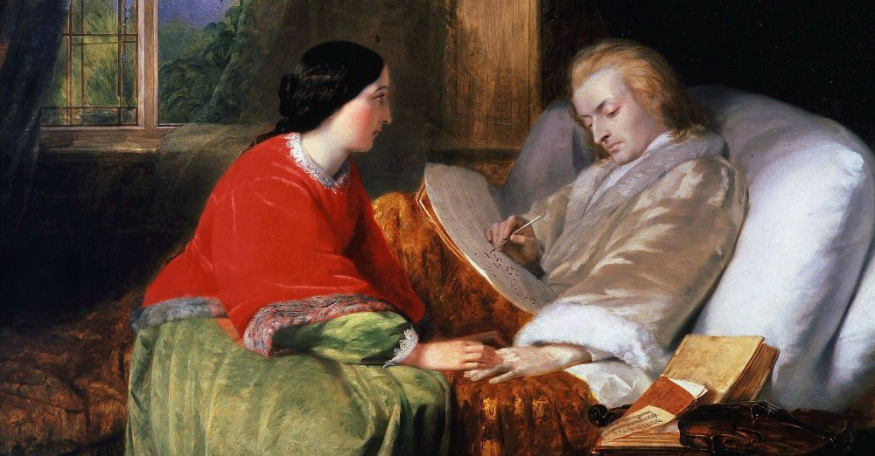
The Story of “Don Giovanni’s” Overture Mozart’s Midnight Masterpiece
29th October 1787 - Midnight of “Don Giovanni’s “ Premiere
Fun Fact: It took him 3 HOURS to compose!

Slide 4
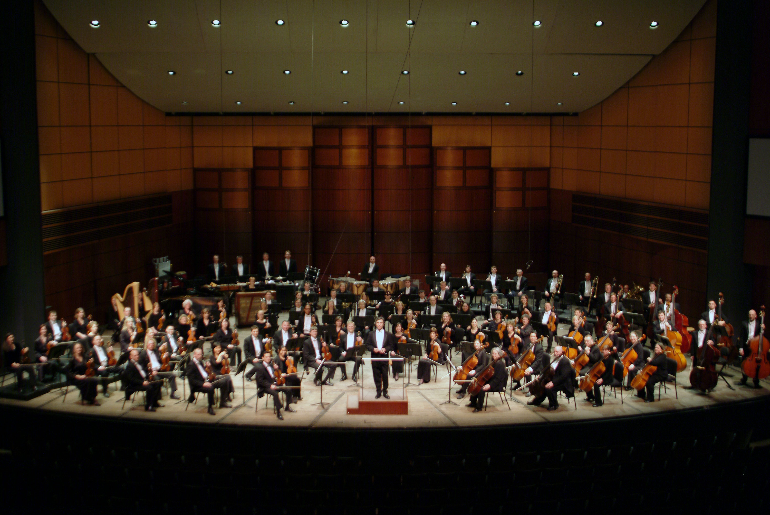
The Story of “Don Giovanni’s” Overture Mozart’s Midnight Masterpiece
29th October 1787 - Night of “Don Giovanni’s “ Premiere
Copyists had JUST made copies of the Overture!
Orchestra Assembled, Crowd Gathered!

Slide 5
The Story of “Don Giovanni’s” Overture Mozart’s Midnight Masterpiece
29th October 1787 - Night of “Don Giovanni’s “ Premiere

Slide 6
The Story of “Don Giovanni’s” Overture Mozart’s Midnight Masterpiece
A 6:10 music piece composed in 3 hours.
Done on the midnight before the Premier.
Script submitted , copied and distributed to Orchestra just before the curtains lifted.
Musicians practically played the tune on the spot!
Audience did not realize it was all a last minute work!

Slide 7
The Story of “Don Giovanni’s” Overture Mozart’s Midnight Masterpiece
Thank You for your Undivided Attention

